Slide 1
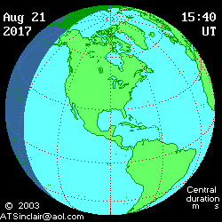
What to Expect during the August 21, 2017 Eclipse
Presentation Copyright © 2005-2017
by Bernie Volz, All rights reserved.
Last updated 07/4/2017
http://www.eclipse2017.org/2017/2017_anim.htm
Notes:
Latest update – June 9, 2014 for 2017 Eclipse

Slide 2
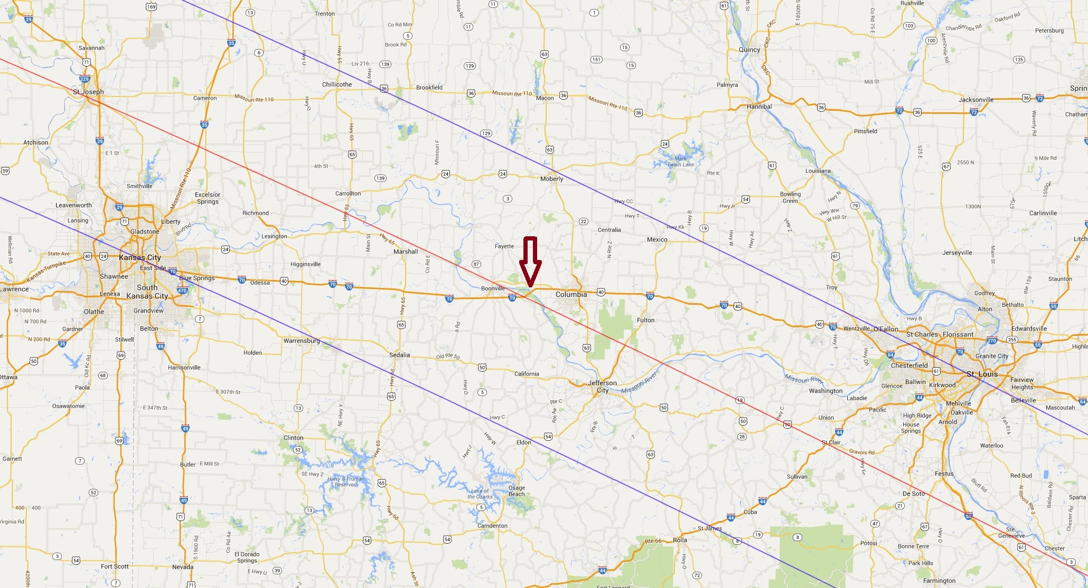
Eclipse Path through Missouri

Slide 3
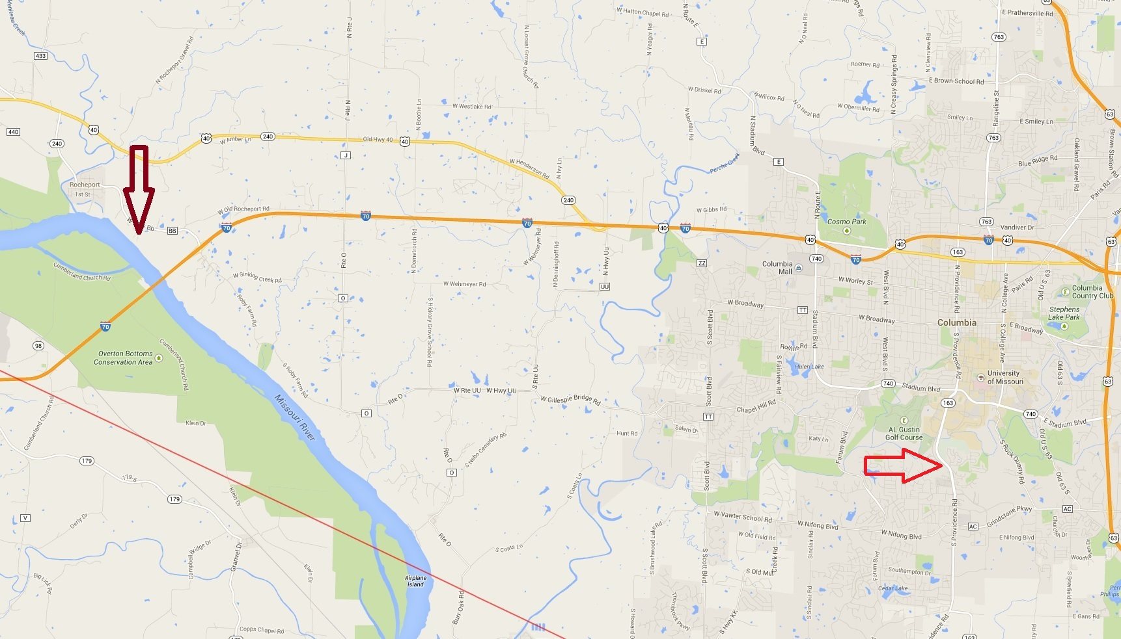
Columbia, MO & Eclipse Site

Slide 4
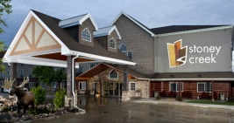
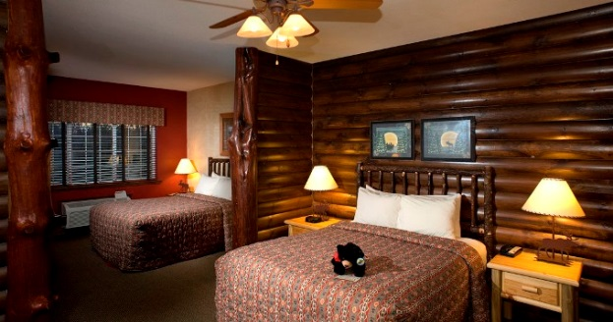
Stoney Creek Inn
Columbia, MO
88% Positive
Ranked #2 of 36 hotels in Columbia
223 Reviews
4.5 out of 5 rating
Certificate of Excellence 2014

Slide 5
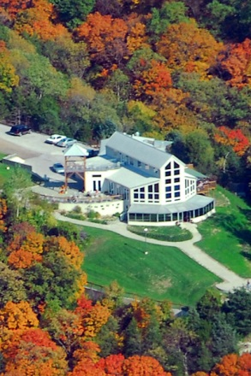
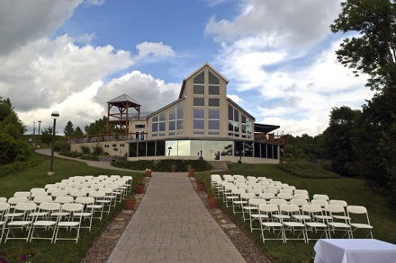
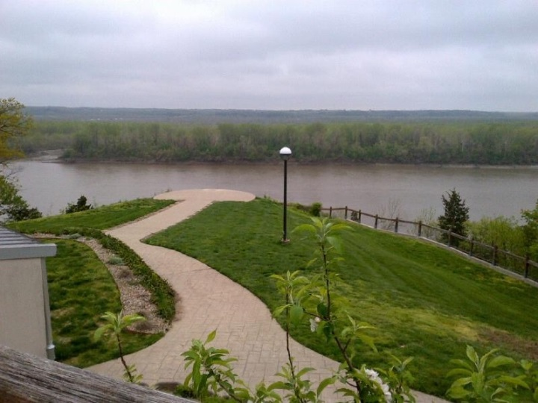
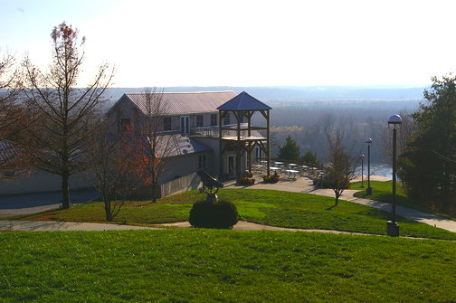
Les Bourgeois Vineyards
Rocheport, MO
Ranked #2 of 4 restaurants in
Rocheport (114 Reviews)
4 out of 5 rating
Certificate of Excellence 2014

Slide 6
Local Circumstances
38° 58' 09.3" N <—> 38.6994° 2m39.0s (total eclipse)
92° 32' 59.9" W <—> -92.5499° Date: 08/21/2017 UT
Umbral depth : 92.21% Obscuration : 100.00%
Magnitude at mid eclipse : 1.014 Moon/Sun size ratio : 1.03054
Event Time (UT) __ Alt __Azi___
Start of partial eclipse (C1): 16:45:12.3 +56.6° 138.2°
Start of total eclipse (C2): 18:11:50.2 +62.9° 179.3°
Mid eclipse: 18:13:09.7 +62.9° 180.0°
End of total eclipse (C3): 18:14:29.2 +62.9° 180.7°
End of partial eclipse (C4): 19:39:47.1 +56.8° 221.2°
Local time is UT -5 hours (C1 = 11:45:12.3, C2 = 13:11:50.2, Mid = 13:13:09.7, C3 = 13:14:29.2, C4 = 14:39:47.1).
Calculated using http://eclipse.gsfc.nasa.gov/SEsearch/SEsearchmap.php?Ecl=20170821

Slide 7
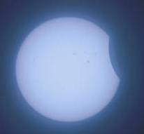
First Contact
Moon begins to move over Sun from West
Starts at ~11:45:12 AM
Must observe sun with filter!
Good time to check and adjust mount tracking and alignment
Watch for sunspots
6/21/2001 – Zambia (Mario Motta)

Slide 8
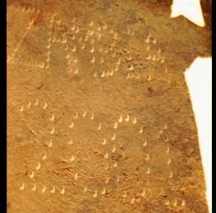
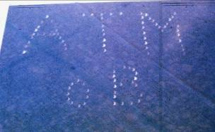
First Contact
Crescent images of Sun
  Natural pin-holes such as leaves on trees
  Pin-holes in cardboard
Watch sky and environment
  Gradually darkens
  Temperature drops
Mario Motta
8/11/1999 Hungary (Eric Pauer)

Slide 9
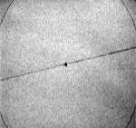
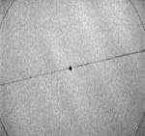
~1 min Before Second Contact
Shadow bands
  Are faint ripples of grayish light that wiggle briskly across landscape
    Similar to ripples seen at bottom of pools
    Caused by atmospheric refraction
  Occur about a minute before Second Contact
  Spread white sheet on ground to see
  Usually not seen unless sky is crystal clear
Photos from http://www.liv.ac.uk/~ggastro/ES.obs.html

Slide 10
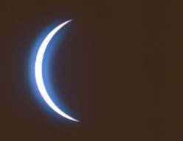
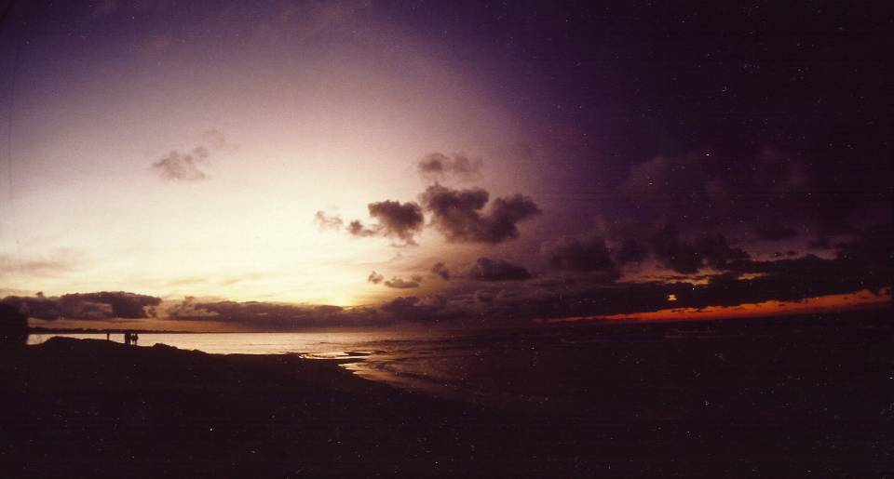
~Minute Before
Second Contact
6/21/2001
Zambia
(Mario Motta)
Onrushing shadow from west
  ~Minute before Second Contact
  Watch color and general appearance
6/30/1992 – Uruguay (Bernie Volz)

Slide 11
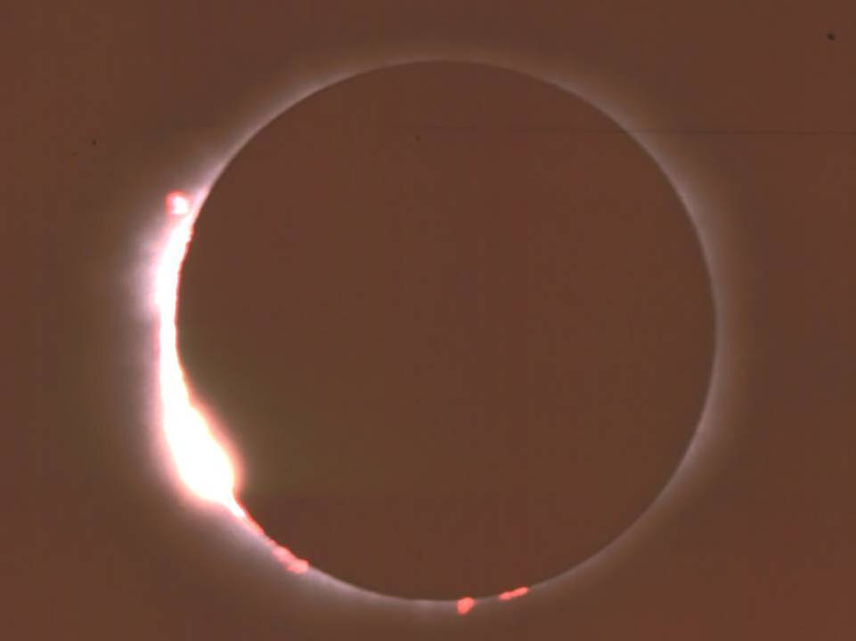
30 Seconds Before
Second Contact
Baily’s Beads (~1:11:20 PM)
  Starts about 30 secs before Second Contact
  Last bit of sunlight shines through the moon’s jagged edge
Filters off of cameras and telescopes!
6/21/2001 – Zambia (Mario Motta)

Slide 12
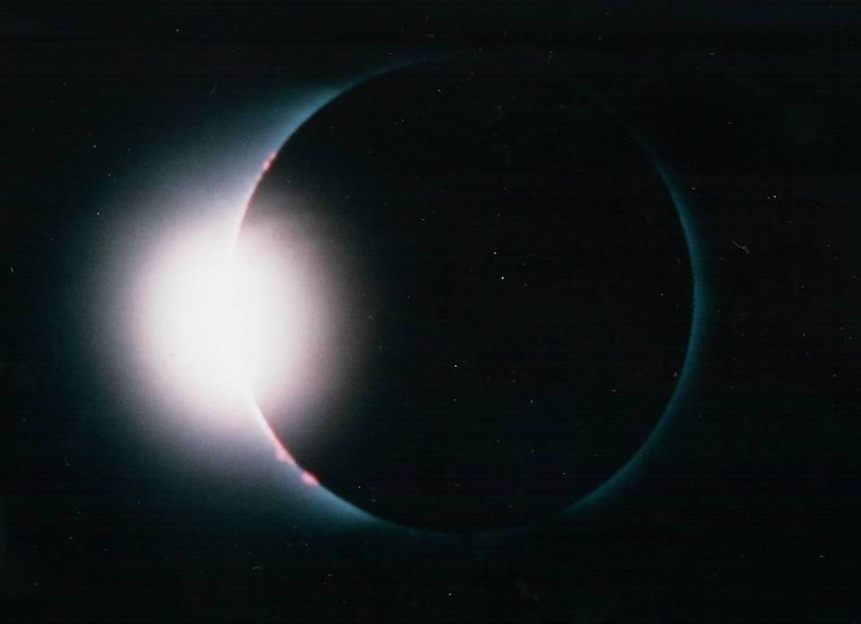
Last Seconds Before
Second Contact
Diamond Ring
  Last “baily’s bead”
  Lasts only a few seconds before Moon completely covers the Sun
11/3/1994 - Bolivia

Slide 13
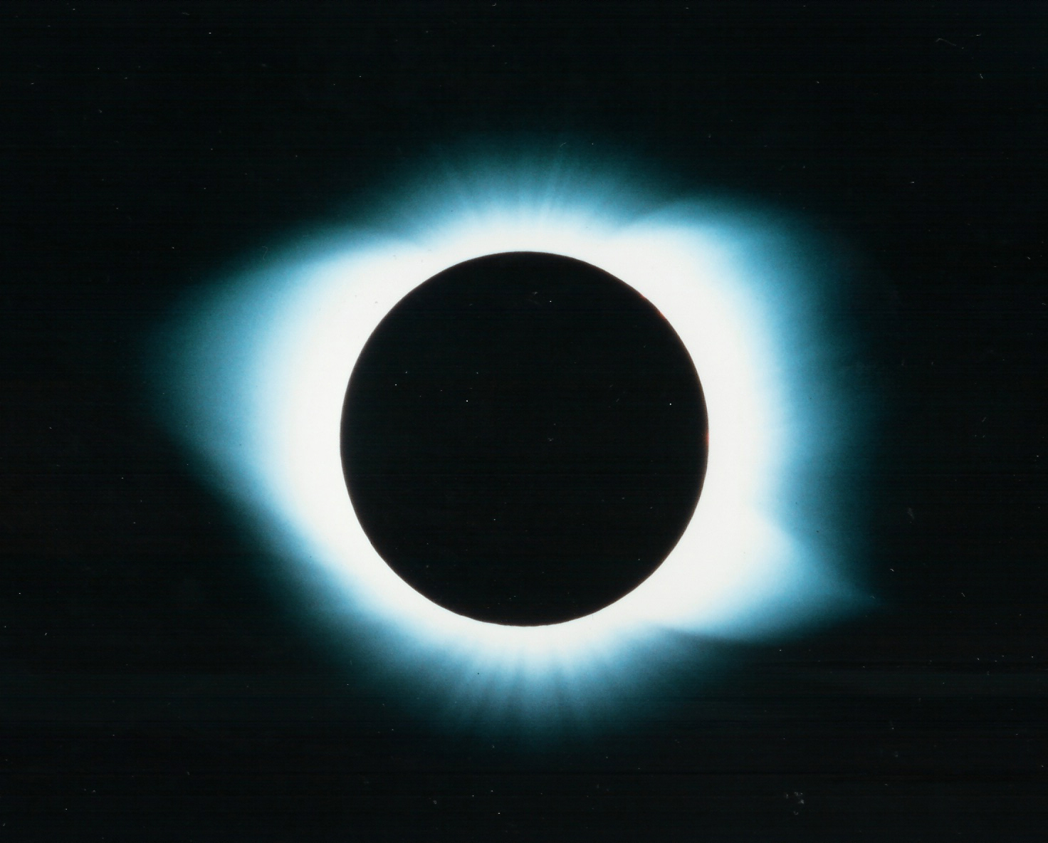
Second Contact
Start of TOTALITY!
Moon completely covers the Sun
FILTERS OFF - Safe to directly view totality
At site:
  ~11:11:50 AM
  Lasts for 2 minutes and 39 seconds
  Sun/Moon
    altitude of ~62.9°
    azimuth of ~180°
11/3/1994 – Bolivia (Mario Motta)

Slide 14
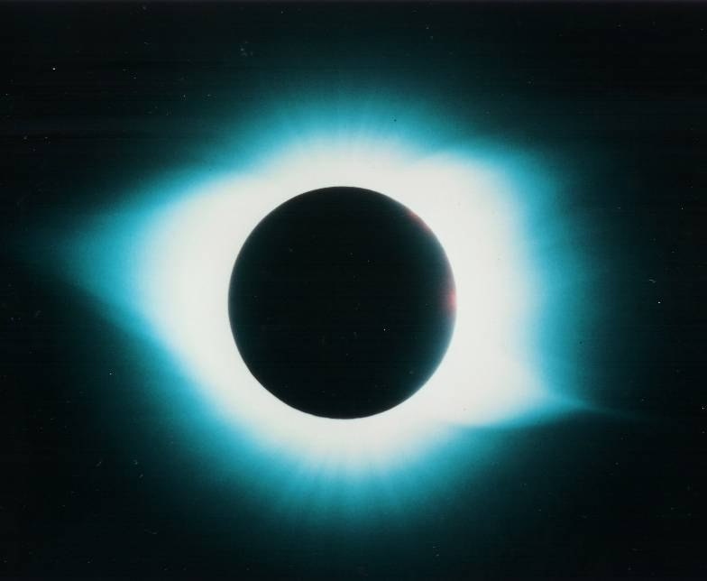
Totality
The Corona
  What everyone is waiting for!
  Best viewed with binoculars
  Look for streamers
  and how far out they go (Sun/Moon are ~½°)
  Each eclipse’s corona is unique - study this one carefully
  Look for polar brushes!
11/3/1994 – Bolivia (Mario Motta)

Slide 15
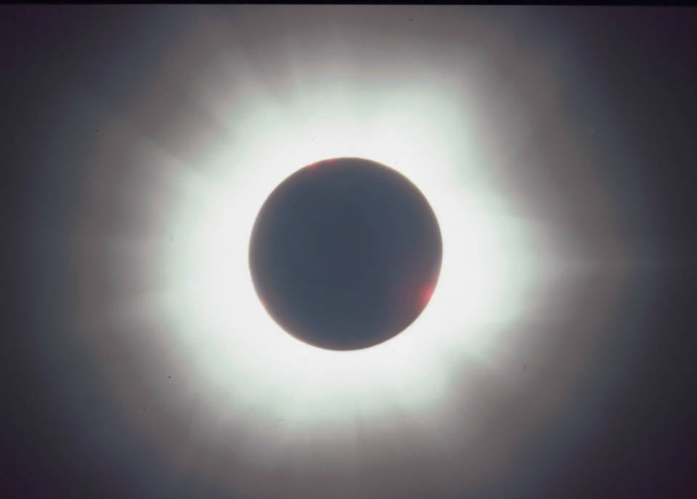
6/21/2001 – Zambia (Mario Motta)

Slide 16
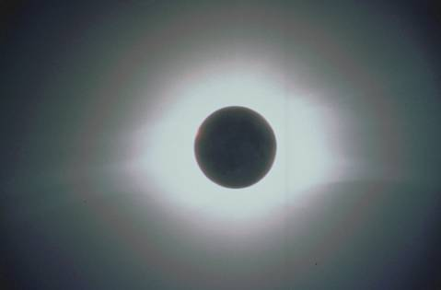
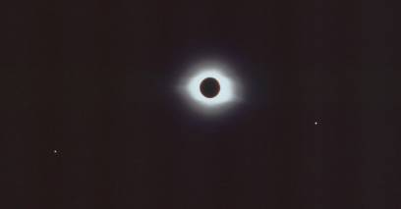
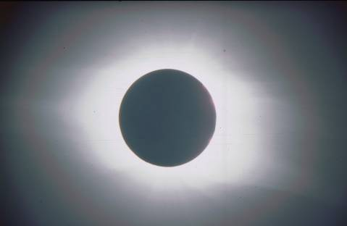
Bernie Volz
Baby Beach, Aruba
2/26/1998

Slide 17
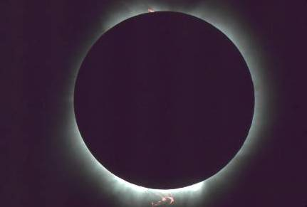
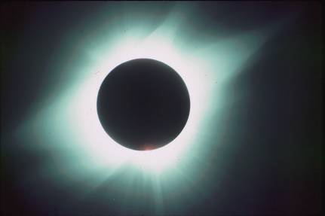
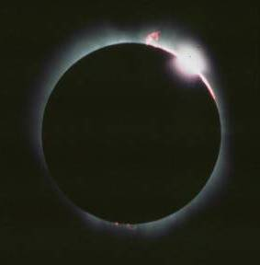
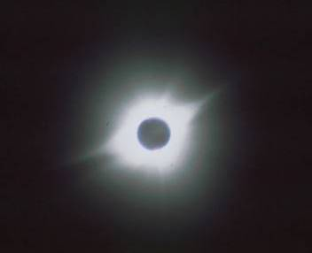
La Paz, Mexico
7/11/1991

Slide 18
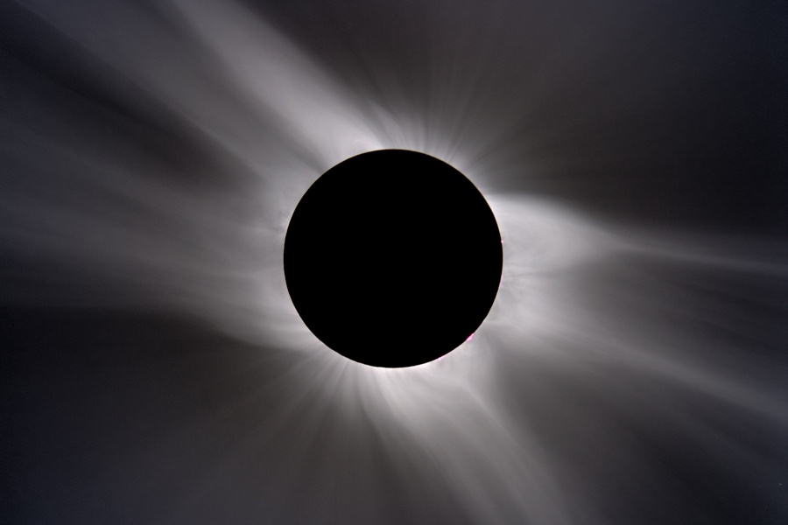
Bert Halstead, March 29th, 2006, Egypt, Composite

Slide 19
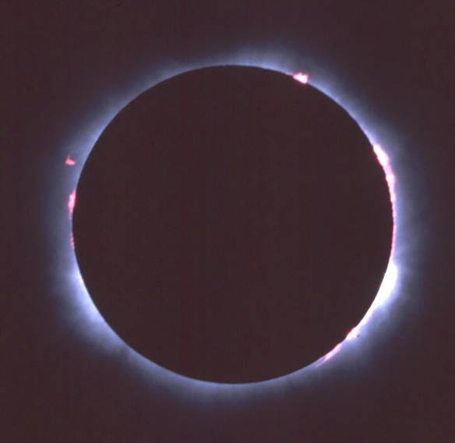
Totality
Prominences
  Red areas near
  solar (lunar) disk
  May have none
  or may have
  several
    Depends on solar activity
08/11/1999 - Hungary

Slide 20
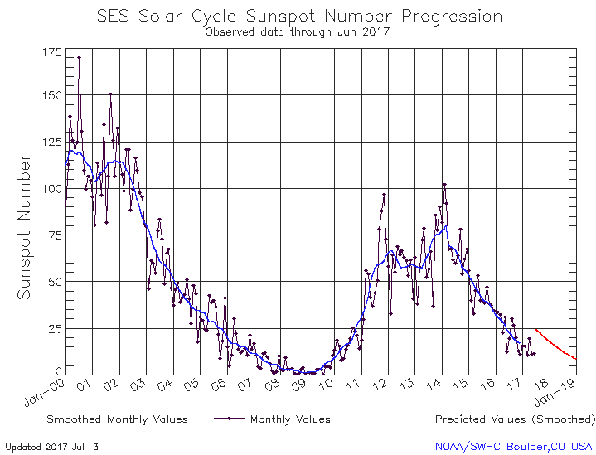
Solar Cycle – Past Solar Max

Slide 21
Totality
Look around at the twilight sky
  Planets
  Stars
  Constellations

Slide 22
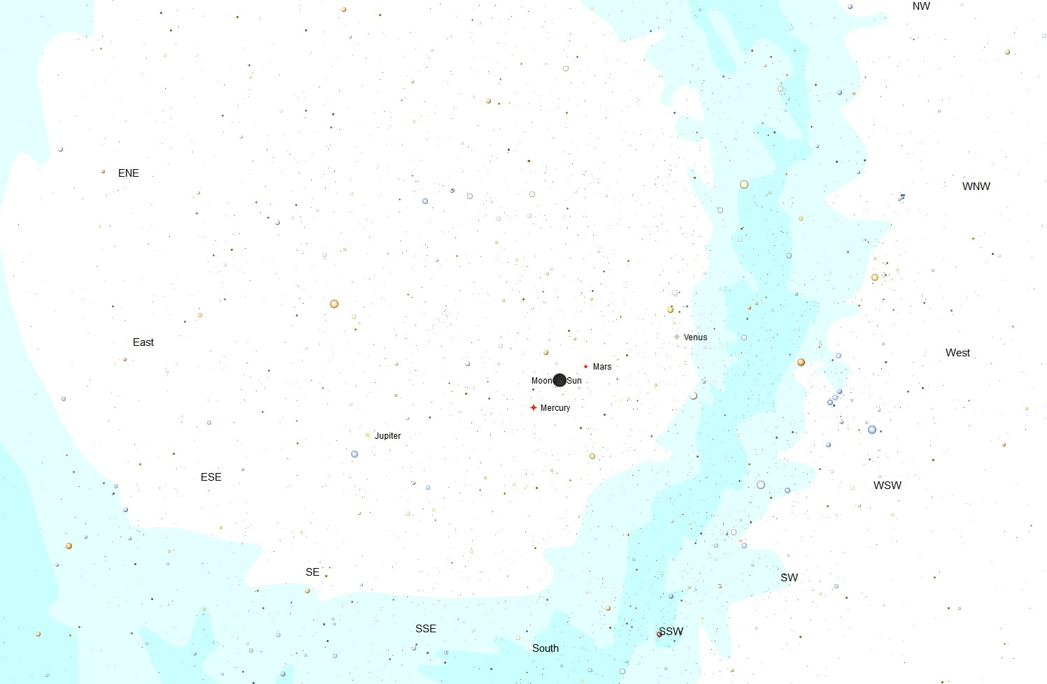
Planisphere
Projection of
Sky during
Totality
Using The Sky X
To use, hold over your head with directions oriented properly.

Slide 23
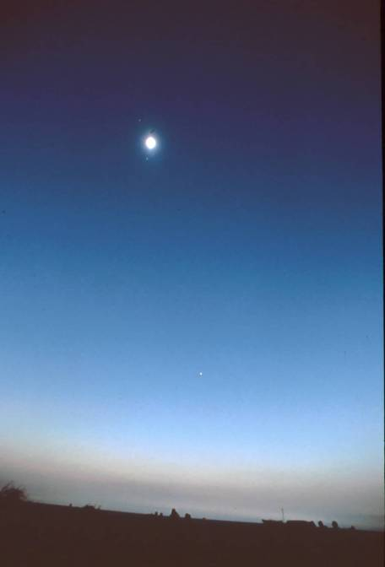
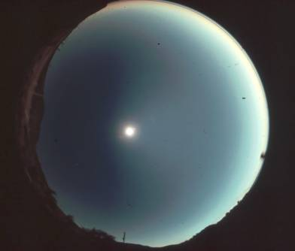
Totality
Take in the environment
  Darkness of eclipse
  Animal reactions
  Temperature drop
  Wind speed
7/11/1991
Mexico
(Mike Terenzoni)
2/26/1998 – Aruba (Peter Bealo)

Slide 24
Totality
Don’t forget to take your photographs
  Don’t need “fast” film - ISO 100 is fine
  Bracket, Bracket, Bracket!
  For Mercury - f/8, ISO 100 = ~1/125
  For Venus - f/8, ISO 100 = ~1/500
Don’t forget to LOOK
You only have 2 minutes and 39 seconds!

Slide 25
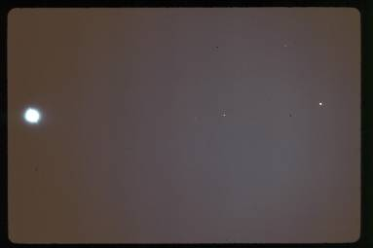
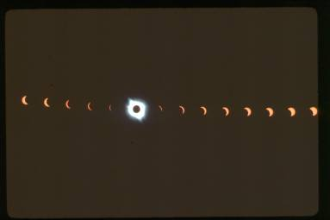
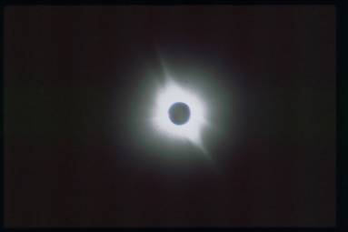
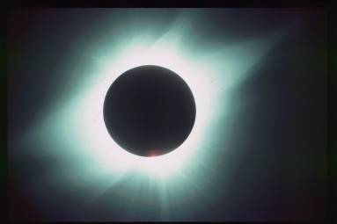
Field of View and Sun’s Image Size vs Focal Length (35mm film)
35 mm
100 mm (Bernie Volz)
270 mm
1000 mm (Mario Motta)

Slide 26
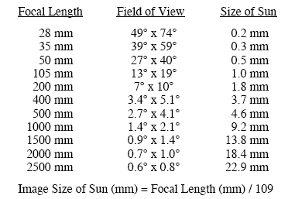
Field of View and Sun’s Image Size vs Focal Length (35mm film)

Slide 27
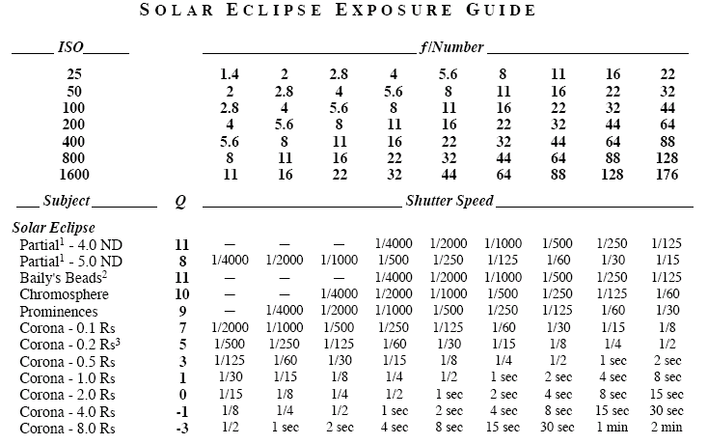
Solar Eclipse Exposure Guide

Slide 28
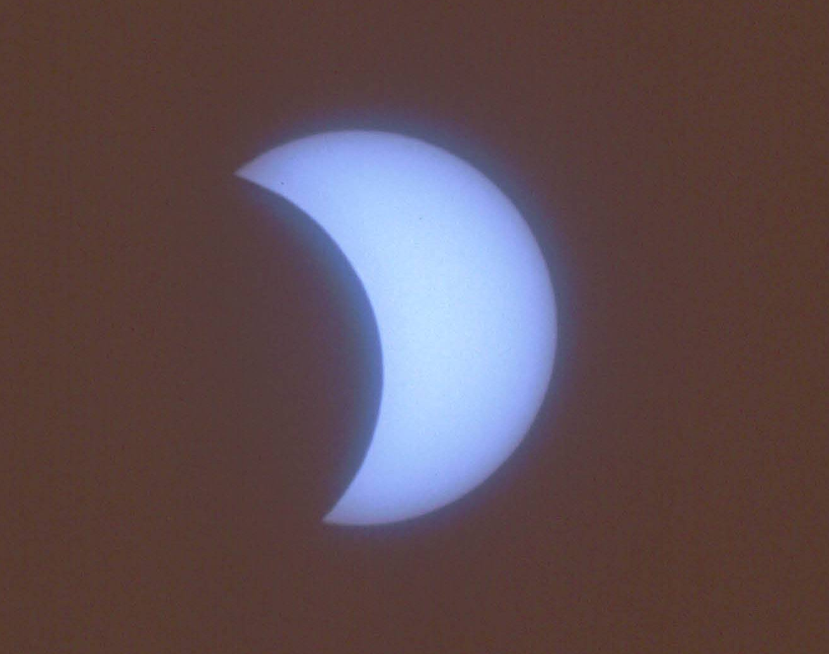
Third Contact
Moon no longer completely covers Sun
Same transition, but in reverse, as from First to Second Contact
  Diamond Ring
  Baily’s Beads
  FILTERS ON!!
  Retreating shadow (East)
  Shadow bands
6/21/2001 – Zambia (Mario Motta)

Slide 29
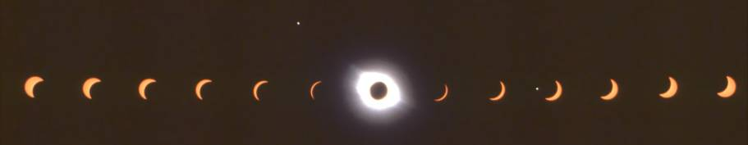
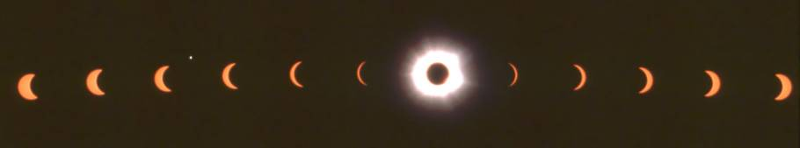
Fourth Contact
Eclipse Ends (~2:40 PM)
  Moon has moved eastward completely off the Sun
2/26/1998 – Aruba (Bernie Volz)
6/21/2001 – Zambia (Bernie Volz)

Slide 30
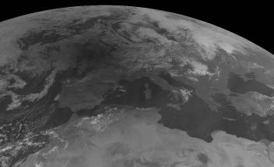
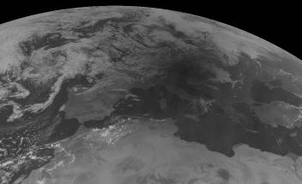
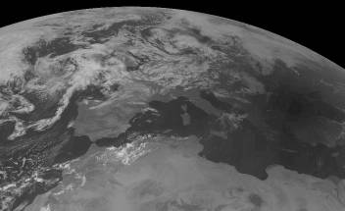
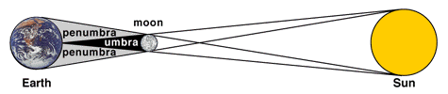
08/11/1999 10:20 UT
08/11/1999 10:50 UT
08/11/1999 11:20 UT

